Slide 2
Agenda
01
What is Electronic Signature
02
What is Changing?
03
Why Sign Electronically?
04
How Does it Work?
05
Resources Available

Slide 3
What is Electronic Signature?
Electronic symbols or processes attached to an agreement and executed by a person with the intent to sign – examples include clicking an "Accept" button online, signing on a touch pad, or typing one's name or initials on a signature line.
Signers can:
(1) select an existing signature suggested by the tool,
(2) draw a new signature, or
(3) upload an image of their own signature.
After signing, the signature gets electronically attached to the agreement.

Slide 4
What’s Changing?
The Bank has mandated electronic signatures for all IBRD/IDA financing agreements concluded with the Bank effective July 1, 2023.
Exclusions:
Agreements for guarantees in support of private sector projects are excluded from the e-Signature modality as they follow a different signing process.
Agreements where countries have legislative restrictions.
Until June 30, 2023
Early Adoption Transition period when both wet ink and electronic signatures will be available.
Effective July 1, 2023
Mandatory Adoption
Electronic signatures will be the default modality, with wet signature option (as a dual modality) only available as an exception for countries with legislative constraints

Slide 5
Why Sign Electronically?

Slide 6
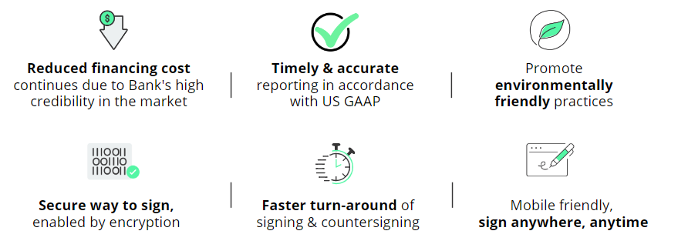
Why Sign Electronically?

Slide 7
How Does it Work?

Slide 8
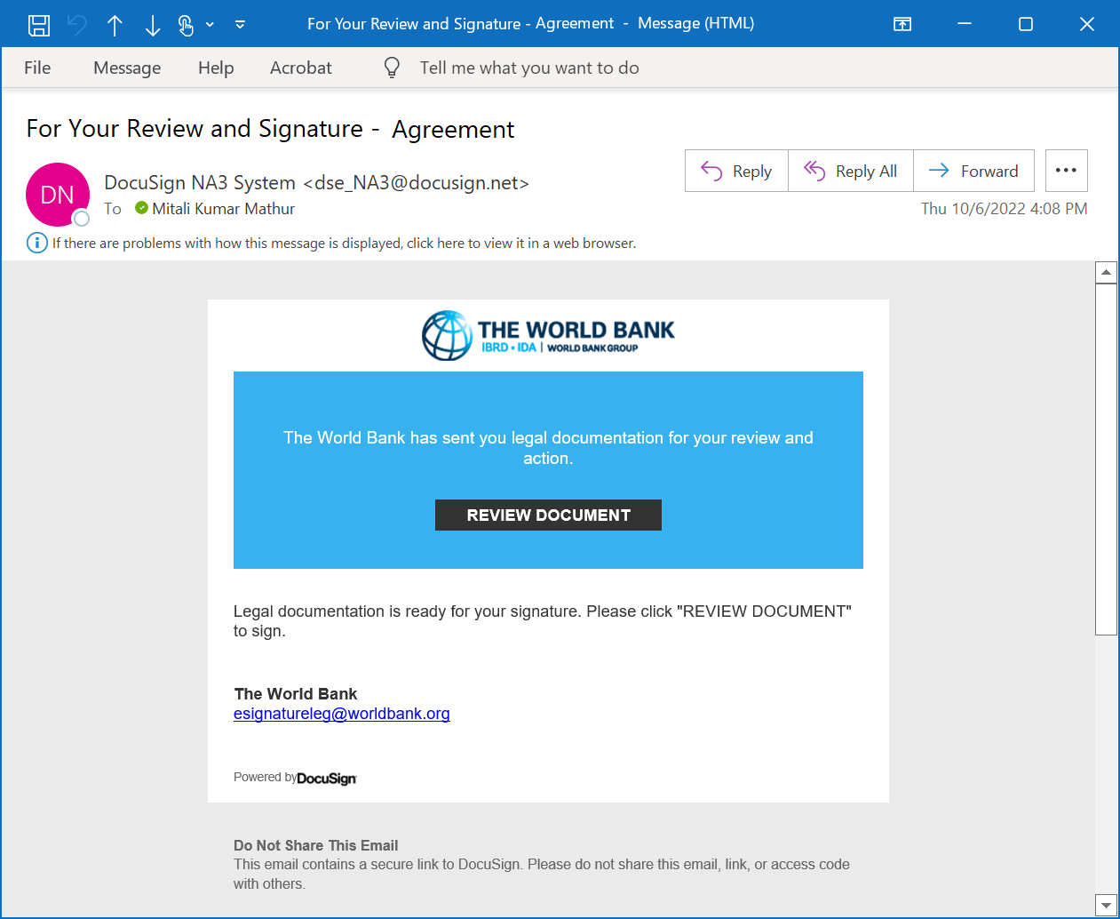
World Bank initiates the process in DocuSign Borrower receives e-mail from DocuSign
Notes:
No change in LEG role
If the borrower is registered with a DocuSign account, she will need to log in to the account.

Slide 9
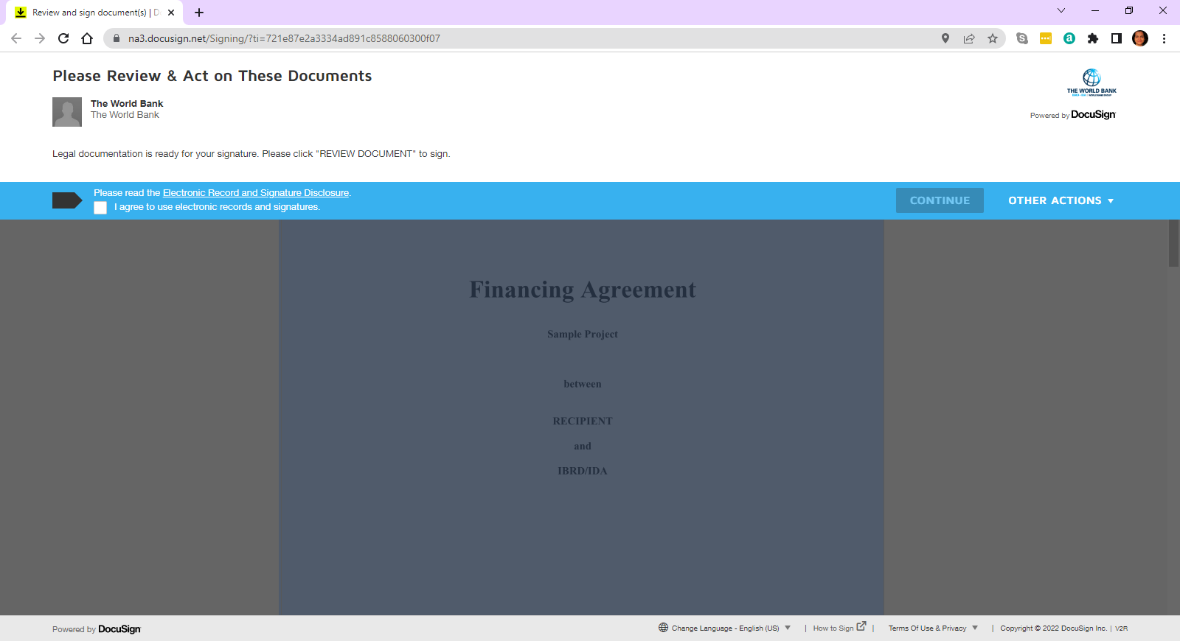
Document opens for review
Notes:
No change in LEG role
If the borrower is registered with a DocuSign account, she will need to log in to the account.

Slide 10
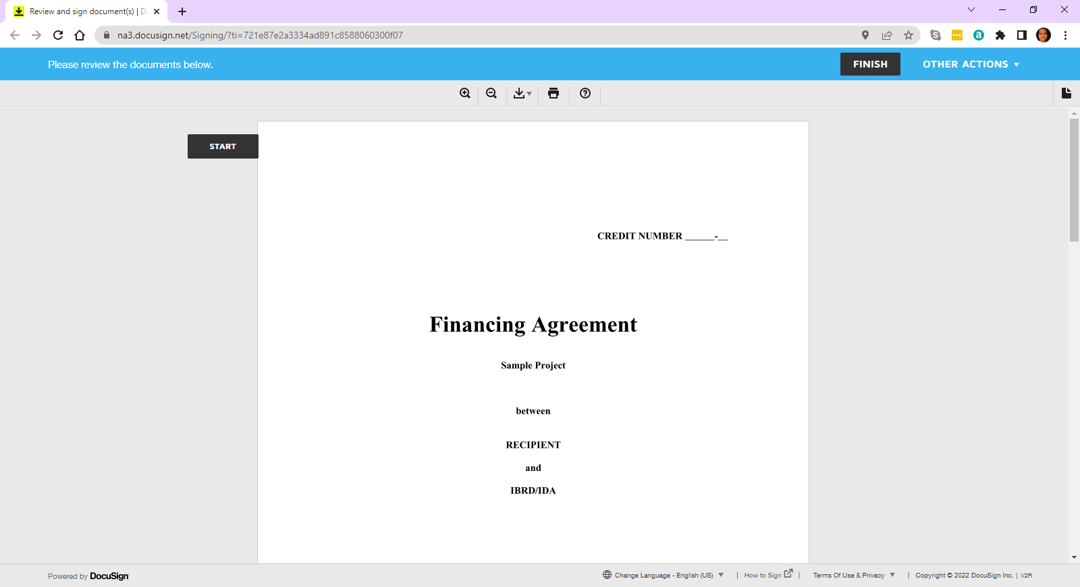
Reviewer scrolls to review the document
Notes:
No change in LEG role
If the borrower is registered with a DocuSign account, she will need to log in to the account.

Slide 11
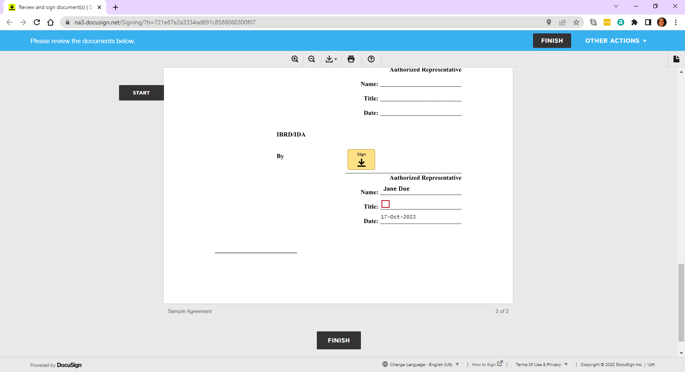
Borrower Rep Click SIGN
Notes:
No change in LEG role
If the borrower is registered with a DocuSign account, she will need to log in to the account.

Slide 12
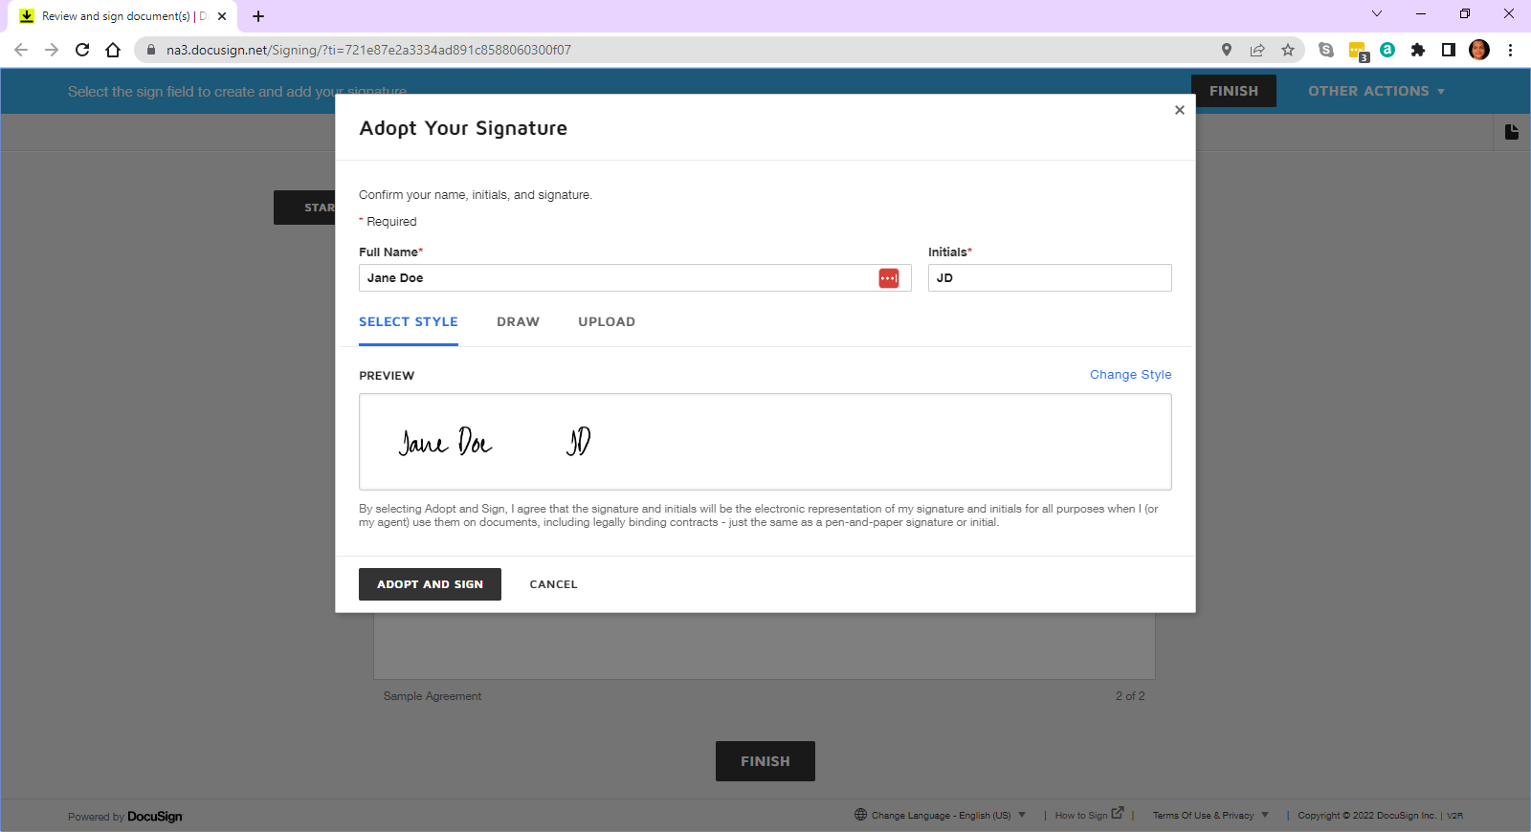
Borrower Rep selects a signature or..
Notes:
No change in LEG role
If the borrower is registered with a DocuSign account, she will need to log in to the account.

Slide 13
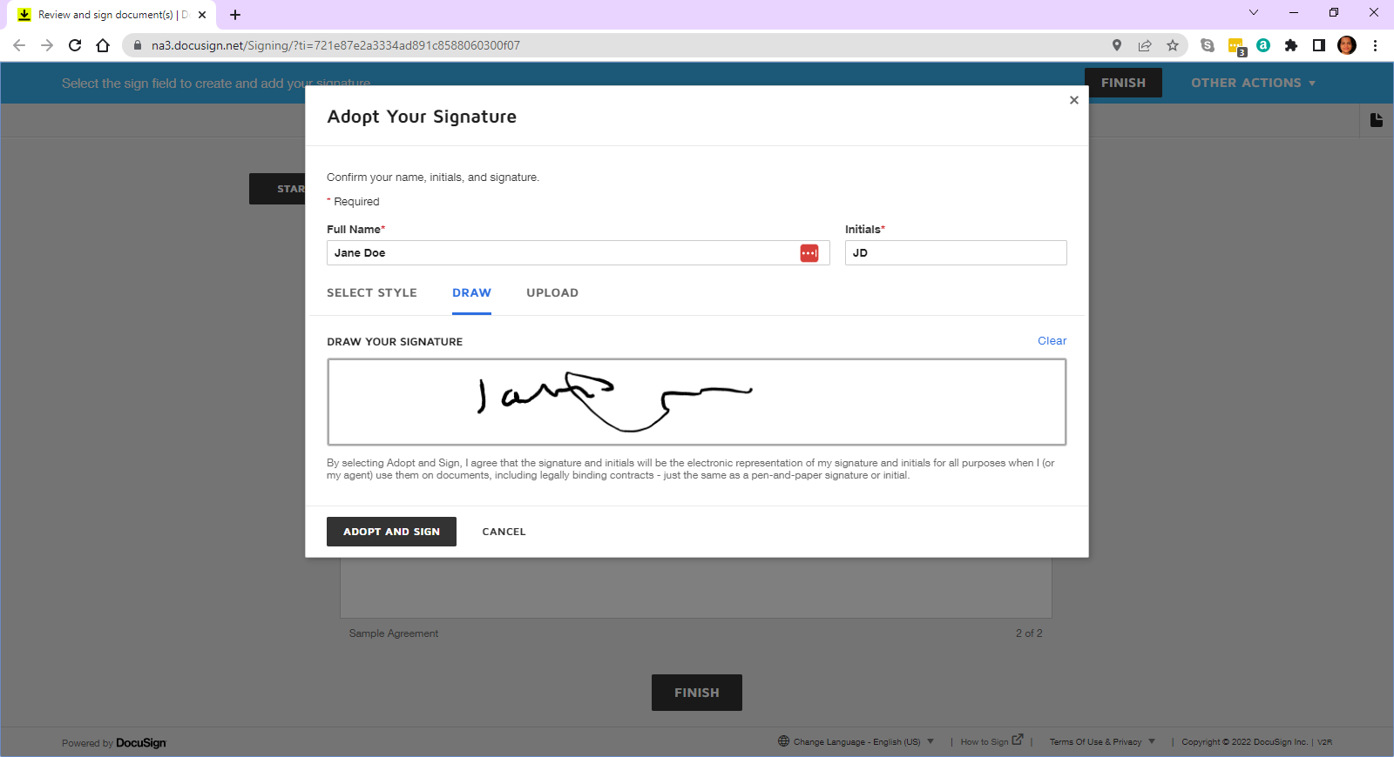
Borrower Rep can draw a signature or..
Notes:
No change in LEG role
If the borrower is registered with a DocuSign account, she will need to log in to the account.

Slide 14
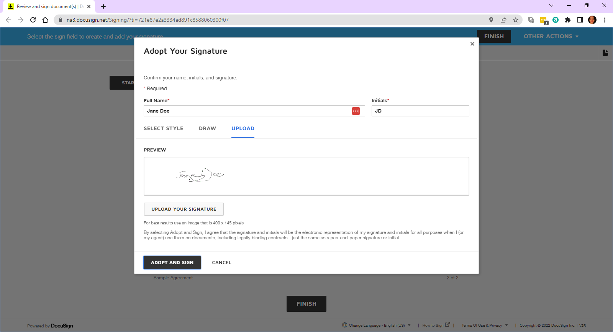
Upload an image of their own signature
Notes:
No change in LEG role
If the borrower is registered with a DocuSign account, she will need to log in to the account.

Slide 15
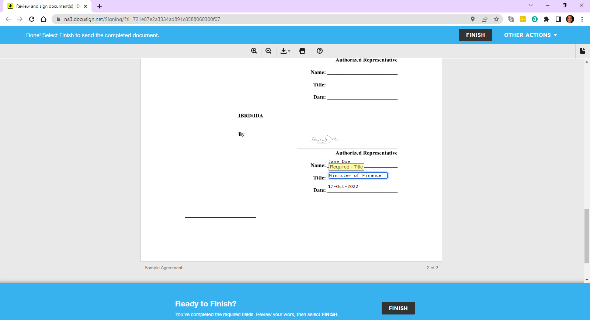
Once the signature is included, they simply click FINISH
Notes:
No change in LEG role
If the borrower is registered with a DocuSign account, she will need to log in to the account.

Slide 16
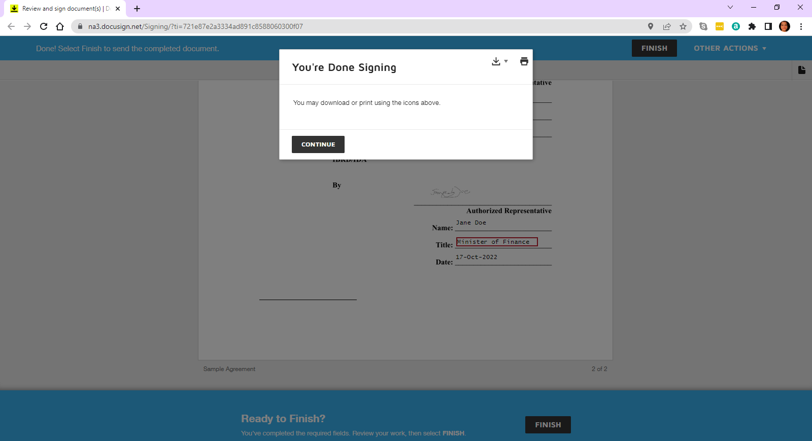
Notes:
No change in LEG role
If the borrower is registered with a DocuSign account, she will need to log in to the account.

Slide 17
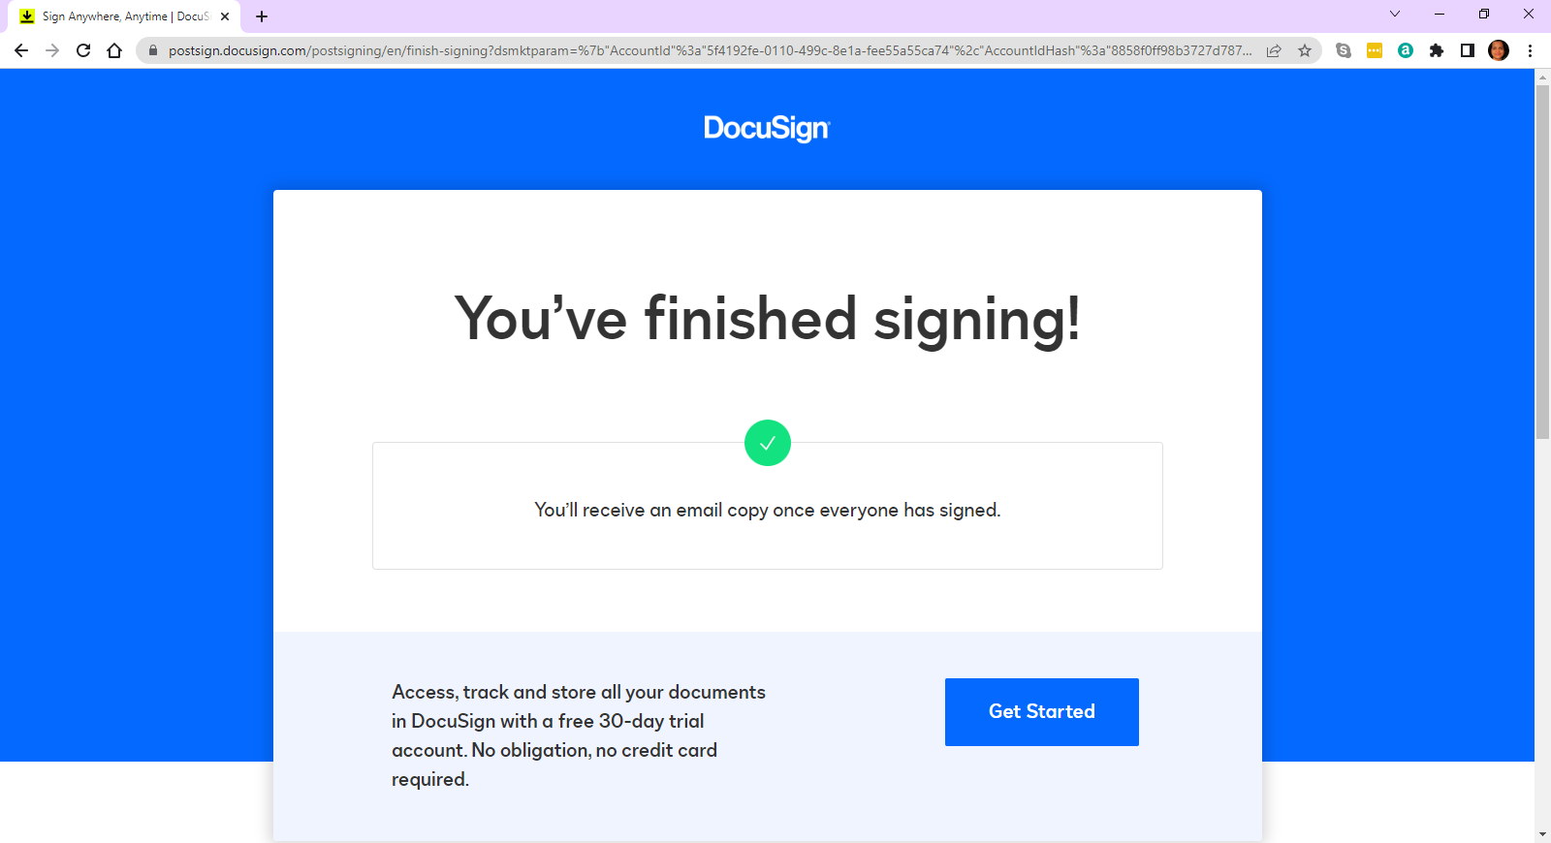
Notes:
No change in LEG role
If the borrower is registered with a DocuSign account, she will need to log in to the account.

Slide 18
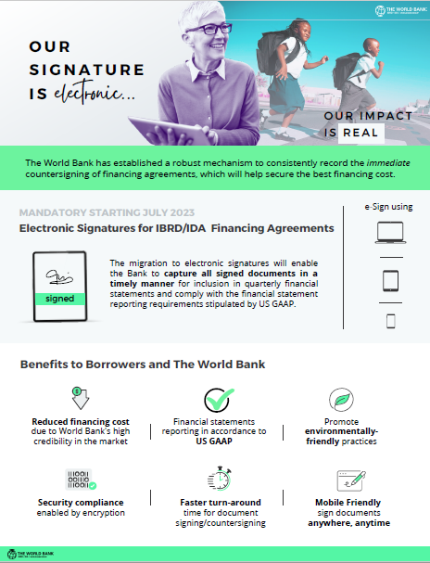
Resources Available on Client Connection
Why Sign Electronically? (Brief 1 min Video)
Overview of e-Signatures at WB (PowerPoint Slides)
e-Signature Mandate (Brief 1 Pager)
Frequently Asked Questions
How to Sign? (Brief 2 min System Demo/Video)
How to Sign? (Quick Reference Guide - 1 Page)
How to Sign? (Detailed Desk Procedure – 5 Pages)
DocuSign Technical Briefing

